Slide 1
Chapter 2: Object Oriented Programming

Slide 2
Learning Objectives
OOPs Introduction
Typing (Types) in C#
C# Arrays
C# Strings
C# Classes and Structs and Enums
Contracts and Interfaces in C#

Slide 3
OOP: Introduction
Object-oriented programming (OOP) refers to a type of computer programming (software design) in which programmers define not only the data type of a data structure, but also the types of operations (functions) that can be applied to the data structure.
C# provides full support for object-oriented programming including encapsulation, inheritance, and polymorphism.
Encapsulation means that a group of related properties, methods, and other members are treated as a single unit or object.
Inheritance describes the ability to create new classes based on an existing class.
Polymorphism means that you can have multiple classes that can be used interchangeably, even though each class implements the same properties or methods in different ways.

Slide 4
Object-Oriented Programming

Slide 5
C# – Types
C# is a strongly-typed language.
Every variable and constant has a type, as does every expression that evaluates to a value.
Every method signature specifies a type for each input parameter and for the return value.
The .NET Framework class library defines a set of built-in numeric types as well as more complex types that represent a wide variety of logical constructs, such as the file system, network connections, collections and arrays of objects, and dates.
The information stored in a type can include the following:
The storage space that a variable of the type requires.
The maximum and minimum values that it can represent.
The members (methods, fields, events, and so on) that it contains.
The base type it inherits from.
The location where the memory for variables will be allocated at run time.
The kinds of operations that are permitted.
You can create your own types by creating Structs, Interfaces, Classes and Enums.

Slide 6
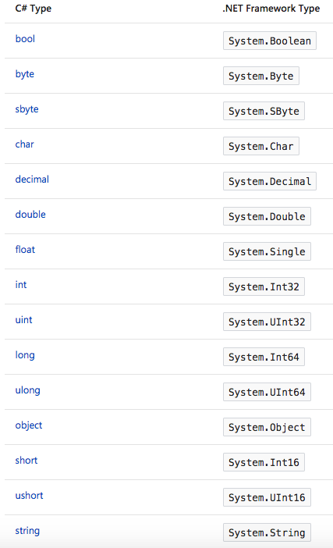
C# – Built-in Types
C# provides a standard set of built-in numeric types to represent integers, floating point values, Boolean expressions, text characters, decimal values, and other types of data.
There are also built-in string and object types.
These are available for you to use in any C# program.
The table on right lists down the built-in types available in C# and the corresponding .NET framework types.
.NET framework has CTS (Common Type System) that enables code written in one language to be compatible and be used by code in other languages; for e.g. you can use a library written in VB.NET in a C# program and vice-versa. All OOP concepts like Inheritance, Polymorphism, Encapsulation and Abstraction are supported by CTS.

Slide 7
.NET – CTS
It is important to understand two fundamental points about the type system in the .NET Framework:
It supports the principle of inheritance. Types can derive from other types, called base types. The derived type inherits (with some restrictions) the methods, properties, and other members of the base type. The base type can in turn derive from some other type, in which case the derived type inherits the members of both base types in its inheritance hierarchy. All types, including built-in numeric types such as Int32 (C# keyword: int), derive ultimately from a single base type, which is Object (C# keyword: object). This unified type hierarchy is called the Common Type System (CTS).
Each type in the CTS is defined as either a value type or a reference type. This includes all custom types in the .NET Framework class library and also your own user-defined types. Types that you define by using the struct keyword are value types; all the built-in numeric types are structs. Types that you define by using the class keyword are reference types. Reference types and value types have different compile-time rules, and different run-time behavior.

Slide 8
.NET CTS Relationships

Slide 9
.NET Value Types
Value types derive from ValueType, which derives from Object.
Types that derive from ValueType have special behaviour in the CLR.
Value type variables directly contain their values, which means that the memory is allocated inline in whatever context the variable is declared.
There is no separate heap allocation or garbage collection overhead for value-type variables.
There are two categories of value types:
struct
enum.
The built-in numeric types are structs, and they have properties and methods that you can access.
Value types are sealed, which means, for example, that you cannot derive a type from Int32, and you cannot define a struct to inherit from any user-defined class or struct because a struct can only inherit from ValueType.
However, a struct can implement one or more interfaces. You can cast a struct type to an interface type; this causes a boxing operation to wrap the struct inside a reference type object on the managed heap.
Boxing operations occur when you pass a value type to a method that takes a Object as an input parameter.
The other category of value types is enum. An enum defines a set of named integral constants.
All enums inherit from Enum, which inherits from ValueType. All the rules that apply to structs also apply to enums.

Slide 10
.NET Reference Types
A type that is defined as a class, delegate, array, or interface is a reference type.
At run time, when you declare a variable of a reference type, the variable contains the value null until you explicitly create an instance of the object by using the new operator, or assign it an object that has been created elsewhere by using new.
An interface must be initialized together with a class object that implements it. If MyClass implements IMyInterface, you create an instance of IMyInterface. We will discuss interfaces and classes in more detail in the coming sections (when we will talk about inheritance).
When the object is created, the memory is allocated on the managed heap, and the variable holds only a reference to the location of the object.
Types on the managed heap require overhead both when they are allocated and when they are reclaimed by the automatic memory management functionality of the CLR, which is known as garbage collection. However, garbage collection is also highly optimized, and in most scenarios it does not create a performance issue.
All arrays are reference types, even if their elements are value types. Arrays implicitly derive from the Array class, but you declare and use them with the simplified syntax that is provided by C#.
Reference types fully support inheritance. When you create a class, you can inherit from any other interface or class that is not defined as sealed, and other classes can inherit from your class and override your virtual methods.

Slide 11
Types of Literal Values
In C#, literal values receive a type from the compiler. You can specify how a numeric literal should be typed by appending a letter to the end of the number.
For example, to specify that the value 4.56 should be treated as a float, append an "f" or "F" after the number: 4.56f. If no letter is appended, the compiler will infer a type for the literal.
Generic Types
A type can be declared with one or more type parameters that serve as a placeholder for the actual type (the concrete type) that client code will provide when it creates an instance of the type. Such types are called generic types.
For example, the .NET Framework type List<T> has one type parameter that by convention is given the name T. When you create an instance of the type, you specify the type of the objects that the list will contain.
The use of the type parameter makes it possible to reuse the same class to hold any type of element, without having to convert each element to object. Generic collection classes are called strongly-typed collections because the compiler knows the specific type of the collection's elements and can raise an error at compile-time

Slide 12
Implicit Types, Anonymous Types, and Nullable Types
As stated previously, you can implicitly type a local variable (but not class members) by using the var keyword. The variable still receives a type at compile time, but the type is provided by the compiler.
In some cases, it is inconvenient to create a named type for simple sets of related values that you do not intend to store or pass outside method boundaries. You can create anonymous types for this purpose.
Ordinary value types cannot have a value of null. However, you can create nullable value types by affixing a ? after the type. For example, int? is an int type that can also have the value null. In the CTS, nullable types are instances of the generic struct type Nullable<T>. Nullable types are especially useful when you are passing data to and from databases in which numeric values might be null.

Slide 13
C# Arrays
You can store multiple variables of the same type in an array data structure. You declare an array by specifying the type of its elements.
Array Overview - An array has the following properties::
An array can be Single-Dimensional, Multidimensional or Jagged.
The number of dimensions and the length of each dimension are established when the array instance is created. These values can't be changed during the lifetime of the instance.
The default values of numeric array elements are set to zero, and reference elements are set to null.
A jagged array is an array of arrays, and therefore its elements are reference types and are initialized to null.
Arrays are zero indexed: an array with n elements is indexed from 0 to n-1.
Array elements can be of any type, including an array type.
Array types are reference types derived from the abstract base type Array. Since this type implements IEnumerable and IEnumerable<T>, you can use foreach iteration on all arrays in C#.

Slide 14
Example: Basic Concepts
See OOPC-Chapter1 (MainClass.cs) at https://github.com/DotNetTraining/DotNetEssentials/tree/master/Code/OOPC/OOPC-Chapter1

Slide 15
What are we learning in Next Chapter ?
You will learn about Object-Oriented Programming
We will learn about:
OOPs Introduction
Typing (Types) in C#
C# Arrays
C# Strings
C# Classes and Structs and Enums
Contracts and Interfaces in C#

Slide 16
Thank You !

